Slide 1
Semester Two - Week 4
Data Management and Ethical Considerations in Research

Slide 2
This week’s session focuses on two critical components of research practice:
how to manage data efficiently from an SLR perspective and how to approach ethical issues with care.
I have based the following introductory notes on the prescribed text by Kumar (2011), specifically Chapter 13: Ethical Issues and Chapter 18: Writing a Research Proposal (ethical compliance), as well as other sources as noted in the text.

Slide 3
Data is best managed by following the Research Data Lifecycle, which outlines the stages through which research data moves from creation to long-term preservation.
This cycle supports effective research data management, involving organising, documenting, publishing, and archiving research outputs, including datasets, software, metadata, and observations.
Students are expected to understand both the practical and ethical responsibilities of handling data throughout the research cycle.
Notes:
Research data is best managed through the Research Data Lifecycle, which describes how data moves from its initial creation through processing, sharing and long-term preservation. Although presented as a cycle, these stages are interconnected. Decisions made at the beginning of a project influence what can later be analysed, published, verified or reused.
Research data includes more than conventional datasets. It may include software, code, metadata, observations and analytical records. In a systematic literature review, the research data includes database search results, search strategies, screening decisions, quality-appraisal records, extraction tables and the evidence used in the final synthesis.
Effective management, therefore, requires researchers to organise files consistently, document methodological decisions, use appropriate storage and backup systems, and determine which outputs can be responsibly shared or archived.
Students must also understand their ethical and legal responsibilities throughout the lifecycle. These include maintaining research integrity, protecting confidential information, respecting copyright and database licences, and accurately representing the evidence.
The central message is that research data management is not an administrative activity added at the end. It is an essential part of producing transparent, trustworthy and reproducible research from the beginning.

Slide 4
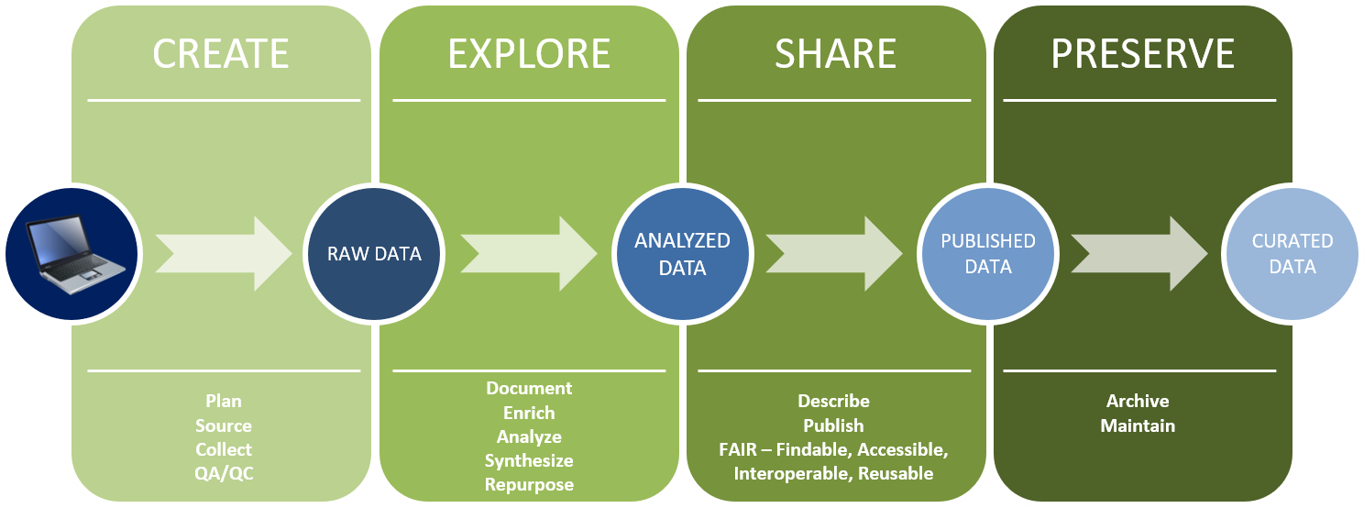
CPUT recommends a Data Management Plan (DMP) outlining how research data will be handled during and after research projects. The purpose of the DMP is to ensure that CPUT complies with all legal, ethical, and contractual obligations and promotes best practices in managing research data.
Figure 1 Research Data Phases
Notes:
Research data management begins before the first piece of data is collected and continues beyond the end of the project. A Data Management Plan, or DMP, provides the roadmap for this process. It explains what data will be created, where it will be stored, who may access it, how it will be protected, and what will happen to it after the research is completed.
The lifecycle shown here moves through four connected phases: create, explore, share and preserve. Although presented as stages, these activities are not always strictly linear. Decisions made during data creation affect what can later be analysed, shared or archived. Preservation must therefore be considered throughout the project, not only at the end.
For CPUT, a DMP also supports compliance with legal, ethical and contractual responsibilities. It protects participants, strengthens research integrity and helps prevent the loss of valuable data. Ultimately, good management ensures that research data remain findable, accessible, interoperable and reusable. Let us begin with the first phase: creating research data.

Slide 5
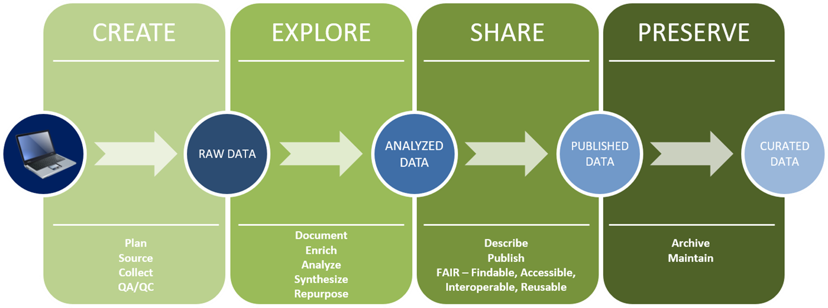
A. CREATE (Raw Data Generation)
Activities involved with the creation of research data include:
Plan: Define research objectives and methods.
Source: Identify tools and data platforms.
Collect: Gather primary data.
QA/QC: Conduct quality assurance and control.
Example:
ICT students conducting a systematic literature review might search databases such as Scopus, Web of Science and IEEE Xplore using a documented search strategy. The bibliographic records and search results become the review’s raw data."
Notes:
The Create phase establishes the foundation of the research project.
Before collecting any data, researchers must clearly define their objectives, research questions and methods. They must also identify appropriate data sources, search tools and platforms. In a systematic literature review, this requires developing a transparent and reproducible search strategy before beginning the database searches.
For example, ICT students conducting a systematic literature review might search databases such as Scopus, Web of Science and IEEE Xplore. They should document the databases searched, the complete search strings, keywords and Boolean operators used, the date of each search, and any filters applied. The bibliographic records and search results retrieved from these databases then become the review’s raw data.
Quality assurance is essential at this stage. Students should verify that the search strategy aligns with the research question, test whether it retrieves relevant studies, and maintain the original database exports before removing duplicates or screening records.
Good organisation is equally important. Files should have consistent names, dates and version information and should be stored securely. A carefully documented Create phase ensures that the review process is transparent, reproducible and ready for the next stage: exploring, screening and analysing the evidence.

Slide 6
B. EXPLORE (Data Processing and Analysis)
Activities involved with the exploration of research data include:
Document: Record methods and metadata.
Enrich: Add contextual data.
Analyse: Interpret data using statistical or qualitative tools.
Synthesise: Integrate different data sources.
Repurpose: Consider secondary use of data.
Example: Students doing an SLR might remove duplicate records, screen titles, abstracts and full texts against predefined criteria, assess study quality, and extract relevant findings into a structured data-extraction table for synthesis.
Notes:
The Explore phase transforms the raw search results into a structured and defensible body of evidence.
In a systematic literature review, this involves more than reading the articles. Every decision about including, excluding, coding and interpreting studies should follow a transparent and consistently applied process.
You might begin by removing duplicate records retrieved from different databases. You then screen the titles and abstracts against predefined inclusion and exclusion criteria. Potentially relevant articles proceed to full-text screening, where eligibility is assessed more carefully. Reasons for excluding full-text articles should be recorded to maintain a clear audit trail and support accurate reporting in the PRISMA flow diagram.
The included studies should then undergo an appropriate quality or critical appraisal process. You can extract relevant information into a structured data-extraction table, including study context, research design, technologies examined, principal findings and reported limitations.
The extracted evidence can then be compared and synthesised to identify patterns, contradictions and knowledge gaps. Throughout this phase, you should document changes to the protocol, screening decisions and analytical categories. This disciplined process makes the synthesis traceable, reduces selection bias and prepares the findings for responsible sharing.

Slide 7
C. SHARE (Dissemination and Access)
Activities involved with the sharing of research data include:
• Describe: Create metadata.
• Publish: Share in repositories or with publications.
• Follow FAIR principles: Ensure data is Findable, Accessible, Interoperable, and Reusable.
Example: Students might share their search strategies, selection criteria, PRISMA flow diagram, data-extraction template and synthesis tables through an institutional repository or as supplementary material, without redistributing copyrighted articles.
Notes:
The Share phase focuses on making the systematic literature review transparent, understandable and, where appropriate, reusable. Sharing does not mean distributing every file collected during the review. It means providing sufficient information for others to understand how the evidence was identified, selected, evaluated and synthesised.
Students might share their complete search strategies, database details, selection criteria, PRISMA flow diagram, data-extraction template and synthesis tables through an institutional repository or as supplementary material accompanying the final publication. These materials allow readers to evaluate the rigour of the review and support researchers who may later wish to reproduce or update it.
The FAIR principles remain relevant. Review materials should be findable, clearly described, stored in accessible formats, and well documented to support responsible reuse. File names, version details, methodological notes and appropriate licences should therefore be included.
Copyright and database restrictions must also be respected. Students should not upload or redistribute copyrighted journal articles unless permission expressly allows it. Instead, they can share bibliographic information, article identifiers, original coding frameworks and independently created synthesis materials. Responsible sharing strengthens the credibility, visibility and long-term scholarly value of the systematic literature review.

Slide 8
D. PRESERVE (Long-Term Stewardship)
Activities involved with the preservation of research data include:
• Archive: Deposit in institutional/national archives.
• Maintain: Update and use open formats for accessibility.
Example:
Students might archive database search records, screening decisions, quality-appraisal results, extraction tables and synthesis files in open formats, with clear filenames, version information and sufficient documentation for future verification or updating
Notes:
The Preserve phase ensures that the evidence and decisions underlying the systematic literature review remain understandable and usable after the immediate project has been completed. Important review materials should not remain only on a student’s personal computer, a temporary cloud folder, or an external drive.
Students might archive database search records, screening decisions, quality appraisal results, extraction tables, and synthesis files in open formats. These materials should have clear filenames, dates, and version information, along with sufficient documentation explaining how they were created and how the review progressed.
Preservation should include the review protocol, complete search strings, database export files, deduplication records, inclusion and exclusion decisions, data-extraction forms, appraisal tools and final synthesis tables. Where possible, open and widely supported formats should be used to reduce dependence on particular software.
Not every downloaded article should be archived or redistributed, because publisher copyright and database licensing conditions still apply. Instead, students can preserve bibliographic records, persistent identifiers and links to the original publications.
Careful preservation creates a defensible audit trail, supports examination or verification, and makes it easier to update the review when new research appears. It therefore extends the reliability and scholarly value of the systematic literature review.

Slide 9
The Research Data Lifecycle illustrates that research data is a critical research output requiring ongoing attention throughout a research project’s lifecycle.
From planning and collection to sharing and archiving, each stage supports transparency, reuse, and the long-term value of research.
It also aligns with global trends promoting open science, data sharing, and robust data stewardship.
In an SLR, research data includes the search results, screening decisions, quality assessments, extracted evidence and synthesis records created during the review. Managing these materials carefully strengthens transparency, reproducibility and future reuse.
Notes:
The Research Data Lifecycle reminds us that data is a critical research output requiring attention throughout the entire project. Good data management begins during planning, continues through collection and analysis, and extends to responsible sharing and long-term preservation.
Each stage contributes to research quality. Careful planning clarifies what data will be generated and how it will be handled. Consistent documentation creates a transparent record of the research process. Responsible sharing allows others to understand or reuse appropriate outputs, while preservation protects their value beyond the immediate project.
This approach aligns with global movements towards open science, responsible data sharing and stronger data stewardship. However, openness does not mean that every file must be made publicly available. Sharing must remain consistent with ethical responsibilities, copyright, licensing conditions and institutional requirements.
In a systematic literature review, research data includes search results, screening decisions, quality assessments, extracted evidence and synthesis records. Managing these materials carefully allows readers to trace how the conclusions were reached. It also supports reproducibility and makes future review updates more efficient.
Good data management is therefore central to producing credible, transparent and enduring research.

Slide 10
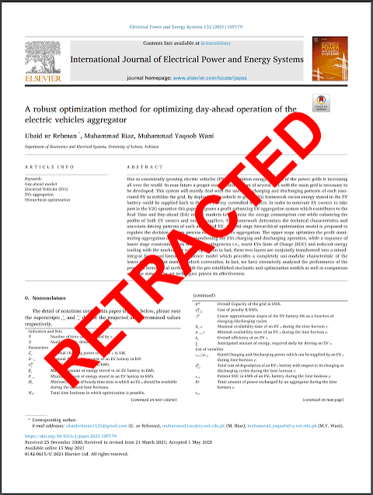
RESEARCH ETHICS IN ACTION
Lessons from
Retraction Watch
A research seminar for undergraduate researchers
Prepared by Dr Errol Francke
https://retractionwatch.com/
https://retractionwatch.com/2024/10/18/plagiarizing-papers-retracted-from-engineering-journal-after-retraction-watch-report/

Slide 11
RESEARCH ETHICS IN ACTION
01
02
03
04
Context
Principles
Cases
Application
What Retraction Watch is and why it matters
Integrity, accountability and public trust
Five examples linked to ethical themes
Guidelines, reflection and teaching use
Research Ethics in Action
02
Notes:
Of interest to us, is the journey from understanding research ethics to applying it in practice.
We begin with Retraction Watch, an independent platform that uses retractions, corrections and expressions of concern to show how scholarly research is produced, scrutinised and corrected. What’s important is that a retraction does not automatically mean deliberate misconduct; it may also result from honest error, unreliable methods or publishing mistakes.
We then consider the principles that should guide responsible research: integrity, accountability, transparency and the protection of public trust. These principles apply throughout the research process, from working with participants and managing data to authorship, peer review and publication.
We will focus on five cases that make these principles tangible. They address participant welfare in gene-editing research, image duplication, alleged reviewer bribery, questionable authorship within a research factory, and AI-fabricated citations. The purpose is not merely to identify wrongdoing, but to ask who was affected, which ethical principle was compromised, what the consequences were and how the problem could have been prevented.
Finally, we translate these lessons into practice: keep accurate records, cite honestly, protect participants and data, disclose conflicts, verify AI-generated material, report findings truthfully and correct mistakes transparently.

Slide 12

What is Retraction Watch?
A journalism platform focused on research correction and accountability
Independent research-integrity journalism Reports on retractions, corrections, expressions of concern and wider threats to the scholarly record.
Window into the research process Shows how research is produced, reviewed, corrected and held accountable.
Its value proposition Turns abstract ethics principles into real cases for classroom analysis.
Research Ethics in Action
03
Notes:
Retraction Watch performs three closely connected functions.
First, it provides independent reporting on retractions, corrections, expressions of concern and investigations into the reliability of published research. This reporting helps us understand not only what happened, but also how authors, journals, publishers and institutions responded.
Second, the Retraction Watch Database provides a structured record of these publishing events. Researchers and students can use it to identify recurring patterns across disciplines, institutions, journals and types of ethical concern. It therefore supports analysis that extends beyond a single high-profile case.
Third, Retraction Watch offers a lens on the scientific process itself. Its cases reveal how publication pressure, competition, weak oversight, conflicts of interest and failures in peer review can affect the production of knowledge.
The important point is that Retraction Watch is not simply a catalogue of scandals. A retraction may follow deliberate misconduct, but it may also result from honest error, unreliable methods or a publisher’s mistake. Our task is therefore not to rush to judgement. We should ask what went wrong, who was affected, whether the response was transparent and proportionate, and what safeguards could prevent a recurrence. Used in this way, Retraction Watch becomes a resource for strengthening accountability and supporting the self-correcting nature of research.

Slide 13
Why retractions need context
A retraction is not automatically proof of deliberate misconduct
Retractions can reveal fraud, serious ethical breaches, honest error, unreliable methods or publisher mistakes.
The learning task is to ask what happened, who was affected and what should change.
Accountability Who accepted responsibility?
Transparency Was the correction clear?
Prevention How can recurrence be reduced?
Research Ethics in Action
04
Notes:
One of the most important lessons in research ethics is that a retraction should never be viewed in isolation. A retraction is a signal that something has gone wrong, but it is not automatically evidence of fraud or intentional misconduct.
Retractions can occur for many different reasons. Some involve serious ethical violations such as fabrication, falsification, plagiarism or manipulation of the peer-review process. Others arise from honest mistakes, such as errors in data analysis, contaminated samples, incorrect statistical methods or conclusions that cannot be reproduced. In some cases, the problem may even lie with the publisher through production or editorial errors.
As researchers, our responsibility is to look beyond the headline and ask critical questions. First, who accepted responsibility for the problem? Did the authors, institution or journal respond appropriately? This tells us something about accountability.
Second, was the correction process transparent? Was the reason for the retraction clearly explained, and were readers informed about what was unreliable? Transparency is essential for maintaining confidence in the scholarly record.
Finally, we should ask what lessons can be learned to prevent similar situations in the future. Were there weaknesses in supervision, research design, peer review, data management or publication practices that need to be addressed?
Rather than treating retractions as evidence of failure alone, we should view them as opportunities to strengthen research practice. Every case provides a chance to reflect on how integrity, accountability and transparency help ensure that research remains credible and worthy of public trust.

Slide 14
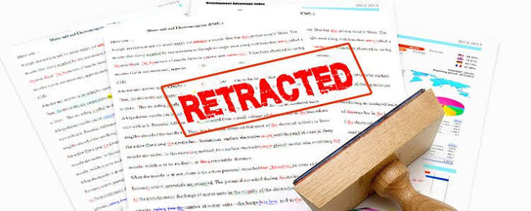
FOUNDATION
Why research integrity matters
Integrity protects the credibility of knowledge itself.
https://www.enago.com/academy/retractions-due-to-image-manipulation-by-esl-authors/
05
Notes:
Research integrity matters because research does not remain confined to a journal article or university repository. Its findings shape further scholarship and may influence decisions about health, education, technology, policy and the allocation of resources. If the underlying evidence is fabricated, manipulated or reported selectively, every later decision based on that evidence may also be compromised.
Integrity therefore protects trust. Researchers, participants, institutions and the public must be able to rely on the honesty of the research process. It also protects impact by ensuring that decisions and innovations are grounded in credible evidence rather than misleading claims.
The reputational consequences extend beyond the individual researcher. Ethical failures can damage students, supervisors, collaborators, departments, universities, journals and even entire fields of study. Rebuilding that confidence can take years.
Integrity also supports learning. Researchers must be able to report negative, unexpected or inconclusive findings without feeling compelled to manufacture a more impressive result. Honest error can contribute to knowledge when it is acknowledged and corrected transparently.
The central message is that research ethics is not merely an administrative hurdle or a form to complete. It is a continuing professional obligation that shapes how we design research, collect and interpret evidence, acknowledge limitations and communicate our findings.

Slide 15
What integrity protects
Three reasons students should care
Public trust Society relies on research when making decisions about health, education, technology and policy.
Accountability Researchers, journals and institutions must be answerable for the claims they publish.
Credibility A corrupted scientific record weakens confidence in institutions and future research.
Ethical conduct is a professional obligation - not an administrative tick-box.
Research Ethics in Action
06
Notes:
This slide highlights three important things that research integrity protects: public trust, accountability and the credibility of the scholarly record.
First, research affects society. Decisions about healthcare, education, technology and public policy are often based on published evidence. When that evidence is reliable, research can support sound
decision-making. When it is distorted or misleading, the consequences may extend far beyond the researcher or institution involved.
Second, integrity creates accountability. Researchers must be able to explain how their studies were designed, how data were collected and analysed, and how conclusions were reached. Journals and institutions also have responsibilities. They must apply appropriate review processes, investigate concerns fairly and correct the record when necessary.
Third, integrity protects credibility. Research develops cumulatively, with new studies often relying on earlier findings. If the scientific record becomes corrupted, later researchers may waste time, funding and effort building on unreliable evidence. Confidence in universities, journals and the research profession may also be weakened.
These are especially important lessons for students because ethical conduct begins during training. Accurate referencing, honest reporting, responsible data management and transparent acknowledgement of limitations are not merely requirements for passing a course or obtaining ethics approval. They are professional habits that shape the kind of researcher one becomes.
The central message is therefore that ethics should not be treated as an administrative tick-box. It is an ongoing professional obligation that protects both the value of research and the people who depend on it.

Slide 16
The major ethical themes
A map of issues drawn from the teaching document
1. Plagiarism
2. Data fabrication
3. Image manipulation
4. Paper mills
5. Authorship ethics
6. AI misconduct
7. Conflicts of interest
8. Human participants
9. Peer review
Research Ethics in Action
07
Notes:
Now, let’s consider a map of the major ethical themes that will guide the rest of our discussion. Although these issues are presented separately, they often overlap in real research cases.
Plagiarism involves presenting another person’s words, ideas or work without proper acknowledgement.
Data fabrication is more serious because it involves inventing data or results that were never actually produced.
Image manipulation becomes unethical when an image is altered in a way that misrepresents the evidence.
Paper mills represent a wider threat to research integrity because they produce or sell fraudulent manuscripts, data or authorship opportunities. This connects directly to authorship ethics. Authorship should reflect genuine intellectual contribution and responsibility, rather than status, payment or institutional pressure.
AI misconduct is an emerging area. The ethical concern is not simply the use of artificial intelligence, but irresponsible use, such as submitting AI-generated work without disclosure, relying on fabricated references or failing to verify its output.
Conflicts of interest arise when personal, financial or professional interests could influence research decisions or the interpretation of findings. These interests must be disclosed and appropriately managed.
Research involving human participants creates additional responsibilities. Researchers must protect dignity, privacy, autonomy and safety through informed consent and appropriate ethical oversight.
Finally, peer review depends on confidentiality, fairness and independence. Manipulating the review process, misusing privileged information or allowing bias to influence an assessment undermines the credibility of publication.
The key message is that research integrity extends across the entire research lifecycle, from developing the study and collecting evidence to authorship, review and publication. These themes give us a framework for examining the cases that follow.

Slide 17
1. Plagiarism and academic integrity
Using sources honestly
• Plagiarism can affect students, faculty and university leaders. • Consequences may include reputational damage, investigations or qualification review. • Students must separate original ideas from borrowed material and cite accurately.
A student's habit of building Cite while drafting, not only at the end. Keep source notes clearly separated from your own wording.
A fine line…
Where is the line between poor paraphrasing and plagiarism?
Research Ethics in Action
08
Notes:
Plagiarism is not limited to copying an entire paragraph or submitting another person’s work as one’s own. It can also occur when a writer borrows ideas, structure or distinctive wording without proper acknowledgement, or paraphrases so closely that the original source remains recognisable.
The consequences can be serious. Plagiarism may affect students, academics and even senior university leaders. It can lead to disciplinary investigations, reputational damage, the withdrawal of qualifications or the review of previously published work.
For students, the safest approach is to treat accurate citation as a habit rather than something added at the end. Record the full details of every source while reading, clearly separate direct quotations from your own notes, and cite ideas as you draft. This reduces the risk of accidentally presenting borrowed material as original work.
It is also important to distinguish between common knowledge and source-based claims. Not every sentence needs a citation, but any specific argument, interpretation, statistic or idea drawn from another author should be acknowledged.
The question at the bottom of the slide highlights an important grey area: where does poor paraphrasing end and plagiarism begin? A paraphrase is not ethical simply because a few words have been replaced. The writer must genuinely restate the idea in a new structure and voice, while still citing the source.
The central lesson is that academic integrity requires both originality and transparency. Your reader should always be able to distinguish your own contribution from the ideas and words you have borrowed from others.

Slide 18
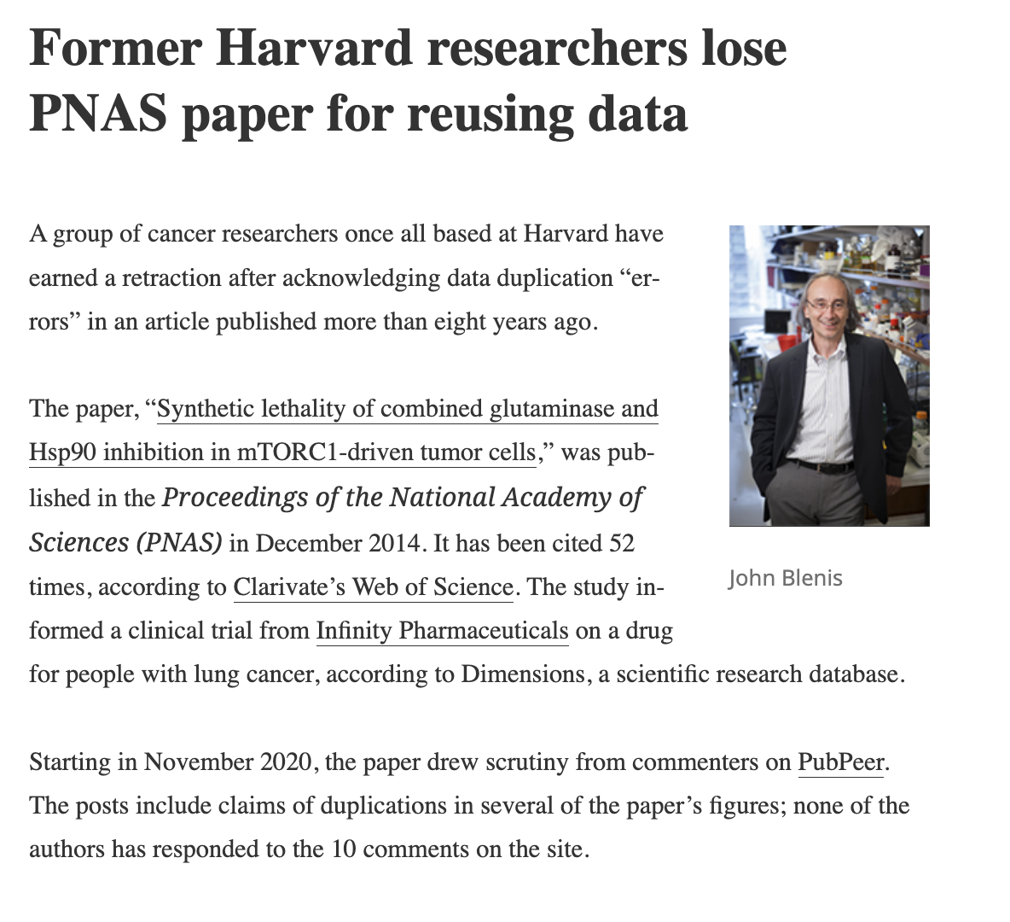
2. Data fabrication and falsification
When numbers stop being evidence
Core distinction Fabrication invents data. Falsification changes or manipulates data. Both mislead future research and waste resources.
Data manipulation
Scientific honesty
Accountability
Institutional responsibility
https://retractionwatch.com/2023/02/01/former-harvard-researchers-lose-pnas-paper-for-reusing-data/
Research Ethics in Action
09
Notes:
There is a distinction between data fabrication and data falsification, two serious forms of research misconduct.
Fabrication occurs when a researcher invents data, participants, observations or results that never existed. Falsification occurs when genuine data are altered, omitted or manipulated so that the research presents a misleading picture.
Although the methods differ, the effect is similar: the published findings can no longer be trusted. Other researchers may waste time and funding attempting to build on false evidence, while institutions, journals and the wider public may make decisions based on unreliable results.
The applied case refers to a retraction involving former Harvard cancer researchers and duplicated image data. This demonstrates that concerns about data integrity are not limited to junior researchers or lesser-known institutions. They can arise in highly respected research environments, which makes independent scrutiny and institutional accountability especially important.
The case also raises questions about responsibility. We should ask who created or reused the problematic material, whether co-authors adequately checked the work, how the journal’s review process responded, and whether the institution acted transparently once the concerns were identified.
The four themes frames our discussion. Data manipulation concerns the immediate misconduct. Scientific honesty concerns the researcher’s obligation to report evidence truthfully. Accountability asks who accepted responsibility. Institutional responsibility considers whether appropriate systems existed to detect, investigate and prevent the problem.
The key lesson is that research integrity depends not only on individual honesty, but also on strong supervision, accurate record-keeping, careful verification and transparent correction when the scientific record is found to be unreliable.

Slide 19
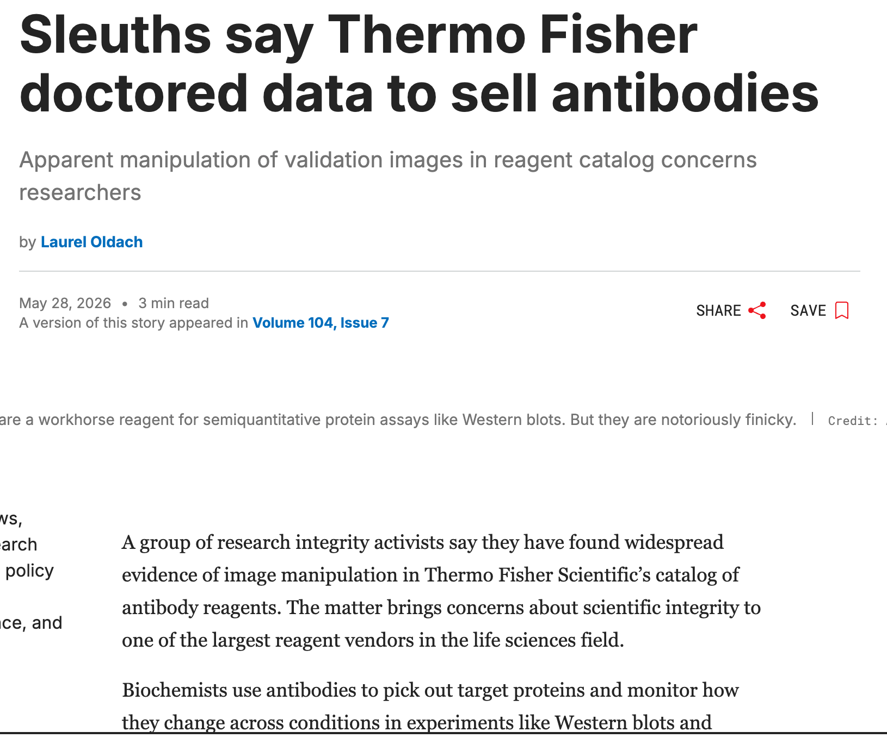
3. Image manipulation
Scientific images are evidence
Images are not decoration. They are part of the research evidence base.
Keep originals Maintain source image files.
Disclose changes Explain legitimate modifications.
Treat as data Apply the same integrity standard as numerical data.
https://cen.acs.org/articles/104/web/2026/05/Sleuths-say-Thermo-Fisher-doctored.html
A fine line…
Why should image duplication be regarded as a data-integrity issue?
Research Ethics in Action
10
Notes:
Depending on the discipline, data may be generated through observations, simulations, instruments, experiments, surveys or interviews.
Scientific images are also research data. They may include microscopy images, diagnostic scans, laboratory photographs or other visual records produced during an investigation. These images are not merely illustrations; they are forms of evidence supporting the findings of a study.
Researchers must therefore retain the original, unaltered image files. Any legitimate modification must be documented and disclosed, and the modified version should be stored separately from the original. Images should never be duplicated, selectively altered or presented in a way that misrepresents the underlying evidence.
The consequences extend beyond one publication. Retraction Watch reported that manipulation of Thermo Fisher’s antibody data resulted in what was described as a “serious breakdown of trust” (Retraction Watch, 2026i).
Once confidence in a dataset is compromised, the organisation responsible may face scrutiny, and subsequent research relying on those findings may also be questioned.
The central message is that integrity begins at creation: preserve the original evidence, document every legitimate modification and maintain a transparent audit trail.

Slide 20
4. Paper mills and research factories
When publication pressure becomes a market
Pressure to publish can create incentives for low-quality or fraudulent output.
Paper mills Produce manuscripts for profit.
Research factories Reward volume over contribution.
Ethical response Prioritise quality over quantity.
Quantity pressure
Integrity risk
Research Ethics in Action
11
Notes:
Another serious threat to the integrity of research data is the growth of paper mills and research factories.
Paper mills are commercial services that exploit the pressure on researchers to publish by producing manuscripts for profit. When these manuscripts are not grounded in authentic and traceable research, the data, analyses and findings they report cannot be treated as credible scientific evidence.
The problem therefore begins before the manuscript is published. Supposed observations, experiments, survey responses, images or datasets may be fabricated, recycled or impossible to verify. Without access to authentic raw data and a transparent record of how it was generated, readers, reviewers and other researchers cannot determine whether the findings are trustworthy.
Paper mills also create an unfair advantage. Genuine research requires time, ethical approval, careful data collection, documentation, analysis and accountability. Purchasing a manufactured manuscript bypasses these responsibilities while allowing publication quantity to appear more important than research quality.
Researchers must be able to demonstrate a clear connection between the original data, the documented research process and the published output.
The key message is that research quality and integrity must always be prioritised above publication quantity. A publication has scholarly value only when the evidence supporting it is authentic, transparent and verifiable.

Slide 21
5. Authorship ethics
Authorship implies responsibility
What unethical authorship does Guest, purchased and ghost authorship misrepresent scholarly contribution.
Applied case A medical student in Nepal associated with a busy research factory raises questions about productivity pressure and authorship practice.
Contribution Meaningful intellectual work
Accountability Own the final work
Transparency No hidden or bought roles
A fine line…
How should contribution to research be evaluated?
Research Ethics in Action
12
Notes:
Authorship is much more than having your name appear on a publication. It signifies that you have made a meaningful intellectual contribution to the research and that you are prepared to accept responsibility for the accuracy, integrity and quality of the final work.
Problems arise when authorship no longer reflects genuine contribution. Guest authorship occurs when someone is listed as an author because of their reputation or position, despite making little or no contribution. Ghost authorship occurs when someone who made a substantial contribution is deliberately omitted. Purchased authorship involves paying to have one's name added to a manuscript without making a legitimate scholarly contribution. Each of these practices misrepresents who actually conducted the research and undermines trust in the published work.
The case highlighted on this slide, involving a medical student in Nepal associated with a high-output research factory, illustrates how intense publication pressure can blur the boundaries of ethical authorship. It raises important questions about whether publication counts are being prioritised over genuine scholarly contribution.
As researchers, we should always ask three questions before accepting authorship:
Did I make a meaningful intellectual contribution?
Am I willing to accept accountability for the entire publication, particularly the parts within my expertise?
Is the authorship process transparent and accurately reflected?
The key message is simple: authorship is earned through contribution, demonstrated through accountability, and protected through transparency. If those three principles are followed, authorship remains a true reflection of scholarly integrity.

Slide 22
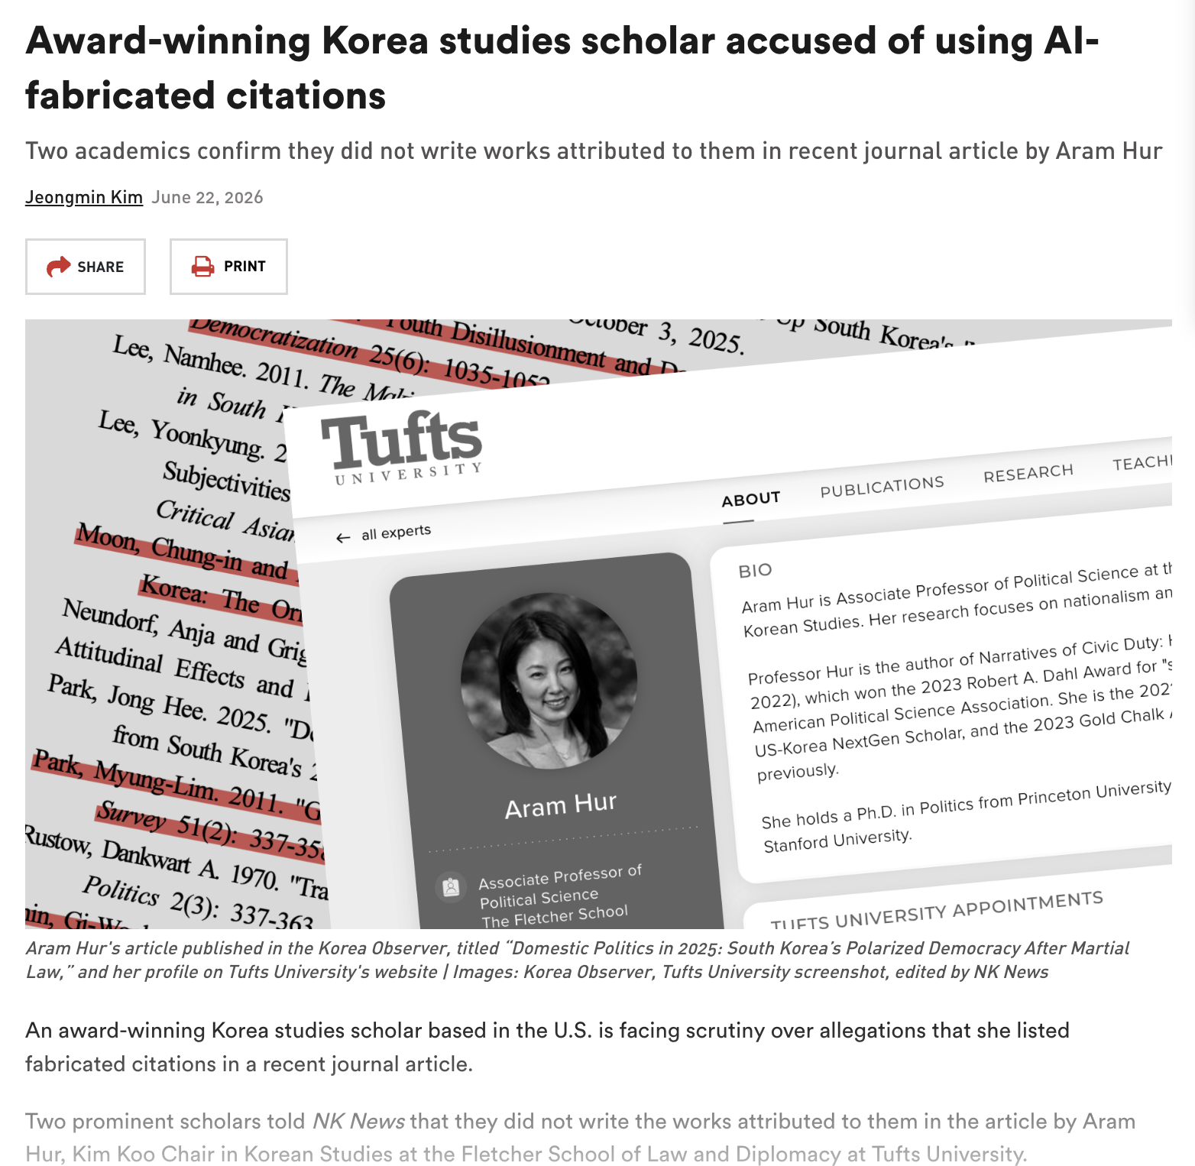
6. Artificial intelligence and research ethics
The author remains responsible
• AI can generate inaccurate summaries. • AI can fabricate citations. • AI can hide uncertainty behind confident wording. • Every claim and reference still needs verification.
A fine line…
Who is responsible when AI generates false information?
Research Ethics in Action
13
Notes:
AI tools can support researchers, but they introduce significant ethical risks.
These include fabricated citations, inaccurate summaries, undisclosed AI-generated content and the possible manipulation of processes such as peer review. An AI-generated response may appear confident and academically convincing while containing information that is incomplete, misleading or entirely false.
Retraction Watch reported that an award-winning scholar was accused of using AI-fabricated citations (Retraction Watch, 2026a). This case illustrates an important principle: the status or experience of a researcher does not remove the obligation to verify evidence.
Researchers remain responsible for every statement, reference and claim they publish, regardless of whether technological assistance was used. AI output should therefore be treated as unverified material. Authors must confirm that cited sources exist, consult the original publications and check that each source supports the claim being made. AI assistance should also be disclosed where required by institutional or publication policies.
The discussion questions for students are: Who is responsible when AI generates false information, and what verification practices should researchers adopt?
Students are encouraged to identify the stakeholders, ethical principles, possible consequences and preventative measures. The central message is simple: AI can assist research, but it cannot assume the researcher’s responsibility for accuracy, transparency and integrity.

Slide 23
7. Conflicts of interest
Disclosure protects both researchers and institutions
Undisclosed financial or professional interests can influence outcomes - or public perception.
Identify What interest could affect judgement?
Disclose Make the interest visible.
Manage Reduce influence on decisions.
Research Ethics in Action
14
Notes:
[Sources] - Source document: conflicts of interest section, lines 127-128.

Slide 24
8. Human participants and research
Participant welfare must come first
Core principle Research involving people requires respect, informed consent, confidentiality and minimisation of harm.
Applied case A high-risk gene-editing therapy case raises questions about adverse outcomes, transparency and public accountability.
https://retractionwatch.com/2026/07/23/exclusive-death-gene-editing-trial-china-nature-science-investigation/
Respect
Consent
Confidentiality
Minimise harm
Transparency
A fine line…
What duties do researchers have to disclose adverse outcomes?
Research Ethics in Action
15
Notes:
[Sources] - Source document: human participants section and gene-editing therapy case, lines 129-137.

Slide 25
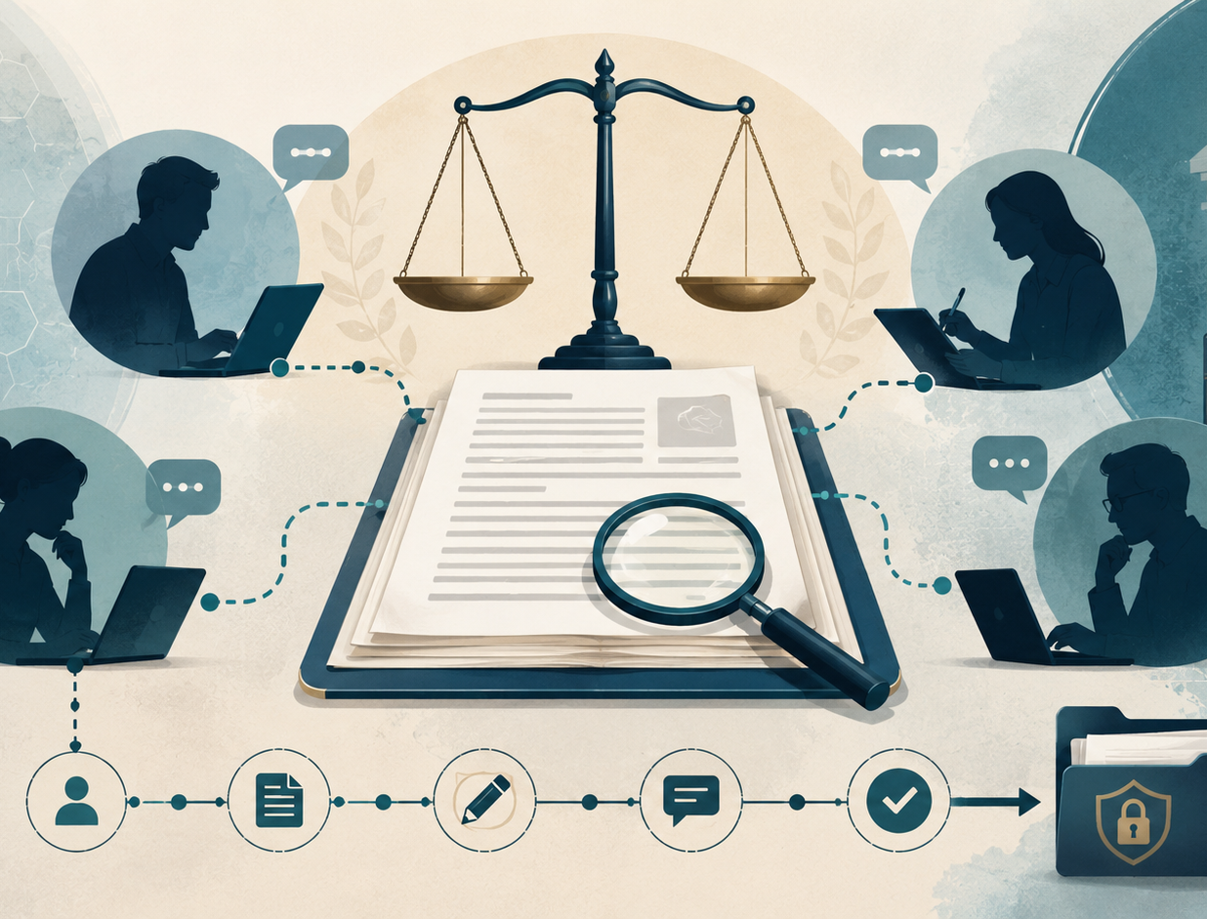
9. Peer review ethics
The review process must be independent and accountable
Peer review depends on Independence, objectivity and accountability.
Applied case An alleged reviewer bribery scheme illustrates how misconduct can undermine publication decisions.
https://retractionwatch.com/2026/07/20/publisher-investigating-peer-reviewer-for-alleged-bribery-scheme/
A fine line…
How can journals strengthen reviewer oversight?
Research Ethics in Action
16
Notes:
[Sources] - Source document: peer review ethics and applied case, lines 141-149. - Visual: generated peer-review accountability illustration.

Slide 26
Comparative overview
Five applied case studies at a glance
Theme
Illustrative issue
Ethical principle
Human research
Gene-editing therapy
Beneficence + transparency
Publication ethics
Image duplication
Integrity of evidence
Peer review
Alleged bribery
Independence + fairness
Authorship culture
Research factory concerns
Accountability
AI ethics
Fabricated citations
Verification + responsibility
Research Ethics in Action
17
Notes:
[Sources] - Source document: comparative overview table, lines 153-176.

Slide 27
APPLICATION
Retractions as learning opportunities
They help us understand quality assurance, accountability and self-correction.
18
Notes:
[Sources] - Source document: retractions as learning opportunities, lines 180-181. - Visual: generated research scrutiny and correction illustration.

Slide 28
Learning from a retraction
A simple analysis sequence to consider when writing an academic piece of work…
1
2
3
4
Identify
Stakeholders
Consequences
Prevention
What ethical issue is at stake?
Who can be affected?
What damage can result?
What safeguards would help?
This converts a news report into an ethics-learning exercise.
Research Ethics in Action
19
Notes:
[Sources] - Source document: reflection activities and lecturer note pattern, lines 186-189 and applied case lecturer notes, e.g. lines 96-97.

Slide 29
Future challenges
Ethical debates will keep shifting
AI Verification, disclosure and fabricated citations
Open science Transparency balanced with privacy and quality
Predatory publishing Misleading journals and publication traps
Publication pressure Quantity incentives versus responsible scholarship
Core principles remain stable even when technologies and publishing systems change.
Research Ethics in Action
20
Notes:
[Sources] - Source document: future challenges section, lines 182-183.

Slide 30
Practical guidelines for students
Eight habits that reduce integrity risk
Keep records
Cite sources
Store data securely
Follow approved methods
Disclose interests
Verify AI outputs
Report truthfully
Correct mistakes
Good ethics is built through small repeatable practices.
Research Ethics in Action
21
Notes:
[Sources] - Source document: practical guidelines section, lines 184-185.

Slide 31
Major considerations
• Critical thinking • Transparency • Accountability • Responsible scholarship
My emphasis Students should evaluate these real-world misconduct cases and consider how ethical failures affect individuals, institutions and society.
A strong ethical foundation early in a research career reduces the likelihood of misconduct.
Research Ethics in Action
23
Notes:
[Sources] - Source document: considerations section, lines 188-189.

Slide 32
Closing lesson
Integrity before prestige
Integrity is more valuable than publication counts, grades or prestige.
Your research output carries YOUR NAME, YOUR SUPERVISOR’S NAME and the CPUT NAME on it!
Protect participants Respect, consent and welfare
Protect institutions Credibility and accountability
Protect knowledge Trustworthy evidence
Research Ethics in Action
24
Notes:
[Sources] - Source document: conclusion, lines 190-191.

Slide 33
References
Primary source:
Retraction Watch newsletters reviewed during July 2026, together with the Retraction Watch website background (https://retractionwatch.com/).
Retraction Watch. 2026a. Award-winning Korea studies scholar accused of using AI-fabricated citations. The RW Daily, 13 July 2026.
Retraction Watch. 2026b. A student claimed to have a PhD in at least eight letters to journals. The RW Daily, 14 July 2026.
Retraction Watch. 2026c. Harvard cancer researchers earn retraction for image duplication. The RW Daily, 17 July 2026.
Retraction Watch. 2026d. Publisher investigating peer reviewer for alleged bribery scheme. The RW Daily, 20 July 2026.
Retraction Watch. 2026e. Medical student in Nepal behind busy research factory. The RW Daily, 21 July 2026.
Retraction Watch. 2026f. Thermo Fisher data manipulation has led to a serious breakdown of trust. The RW Daily, 23 July 2026.
Retraction Watch. 2026g. A couple paid more than $800,000 for a gene-editing therapy for their daughter. The RW Daily, 24 July 2026.
Retraction Watch. n.d. Tracking retractions as a window into the scientific process.
Research Ethics in Action
25
Notes:
[Sources] - Source document: references list, lines 192-201.

Slide 34
THAT’S IT!!!
See you next week

